Slide 1
BOOK MANAGEMENT
Nguyễn Duy Khang – B1910652
Trần Bá Phương - B1908407

Slide 2
List of functions
Guest:
See all books
Search books by title
Login account to manage
Admin
Add categogy
Add book
Edit book
Delete book
Search books by title to delete
Search books by title to edit
Add account manage

Slide 3
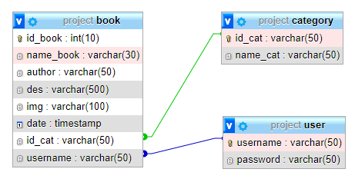
Database

Slide 4
Application
HTML
CSS
PHP
JavaScript (alert())
Pagination
Session
MySQL
File upload
Image saving in DB

Slide 5
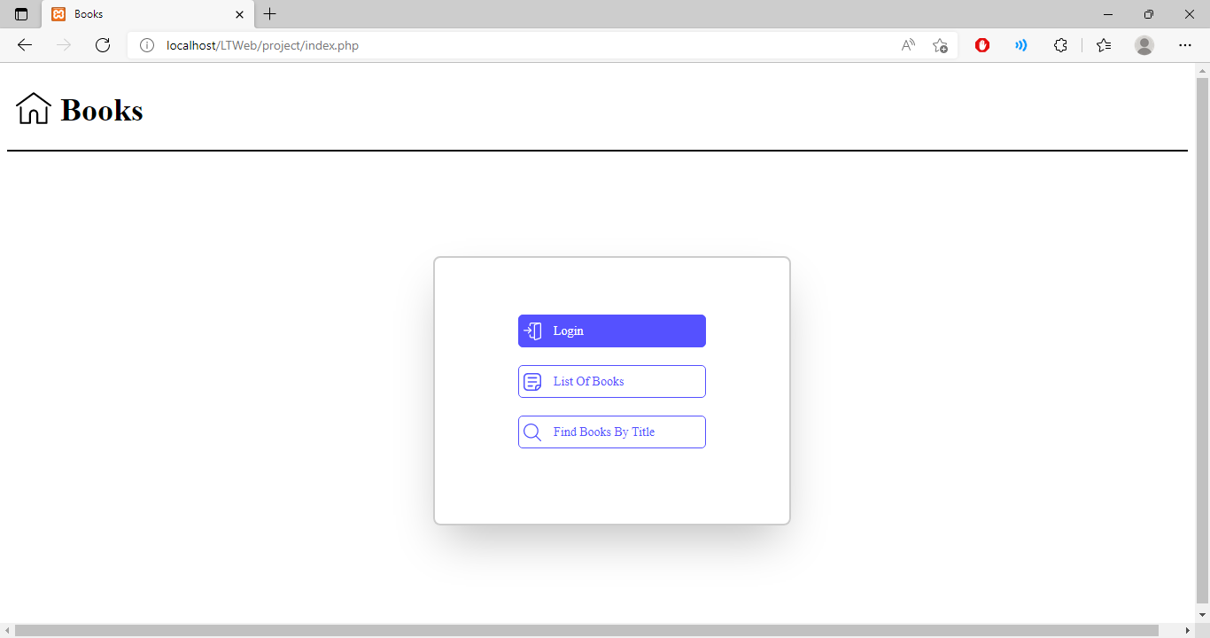
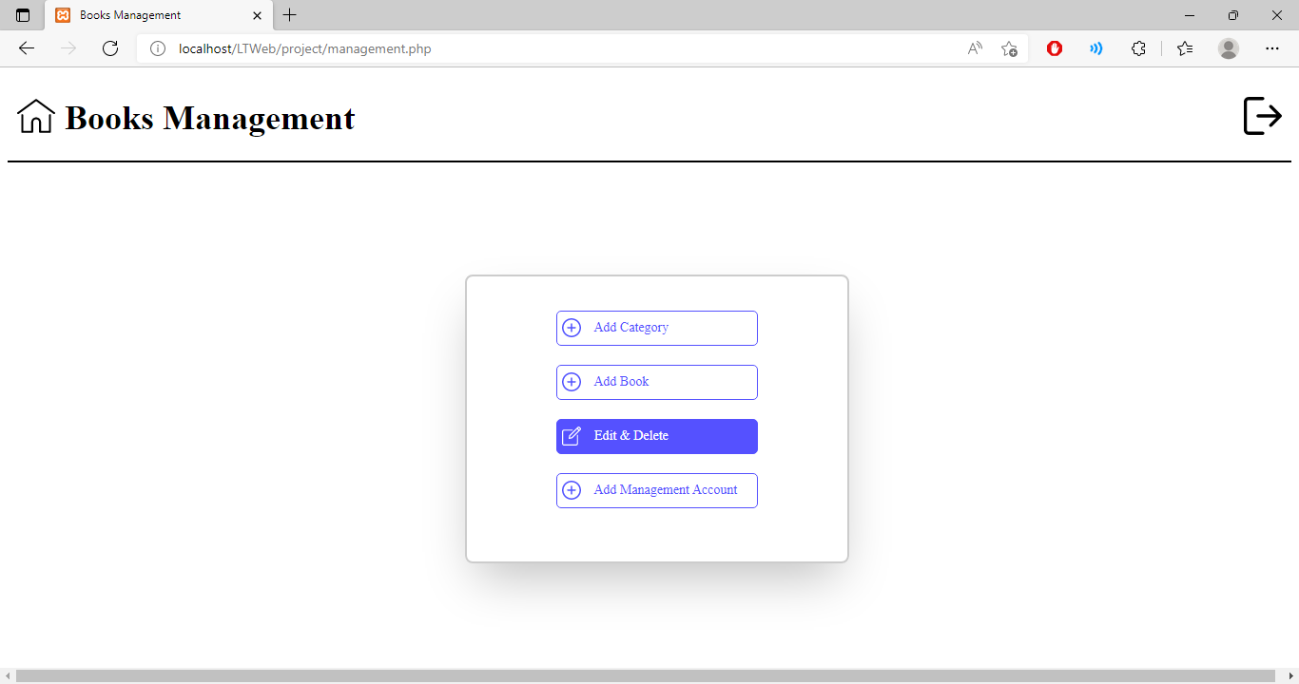
Interfaces

Slide 7
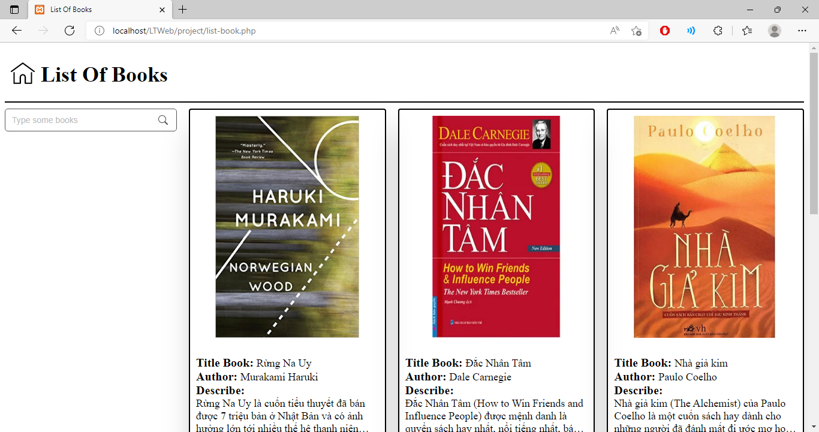

Slide 8
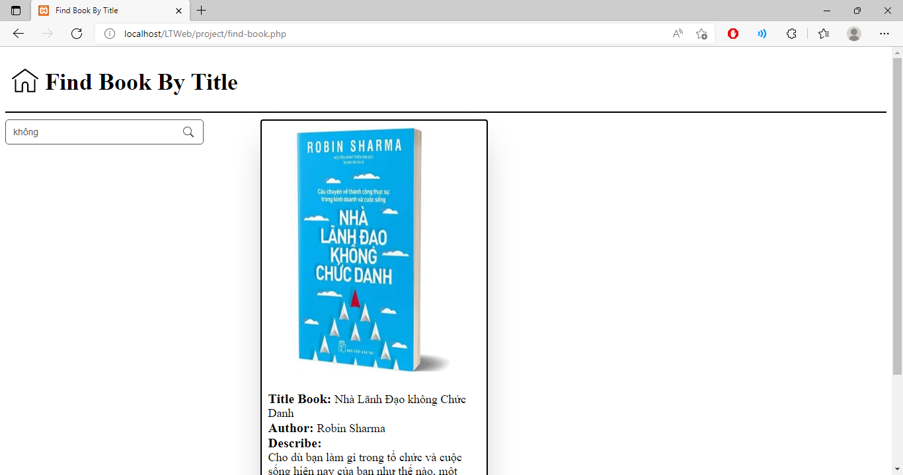

Slide 9
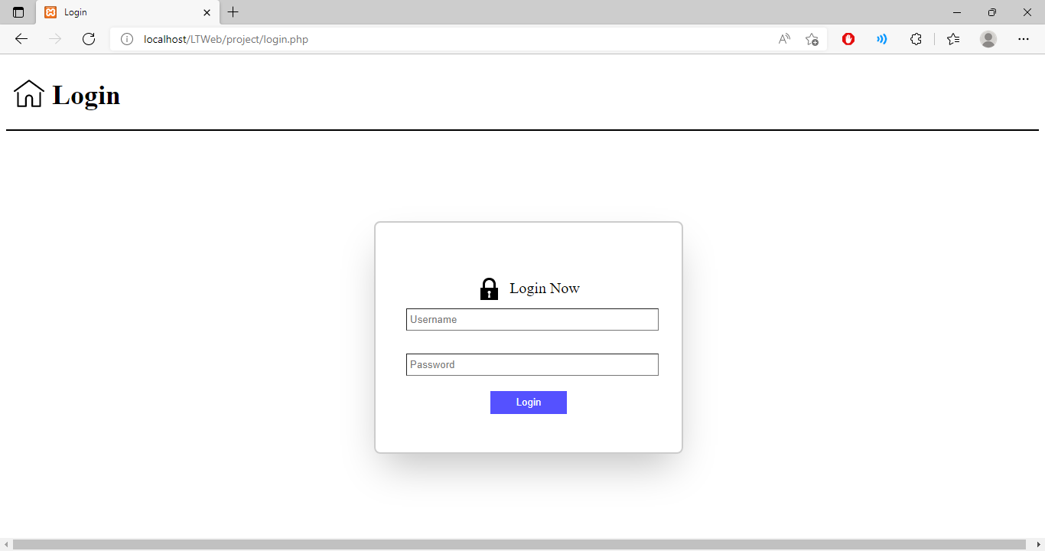

Slide 11
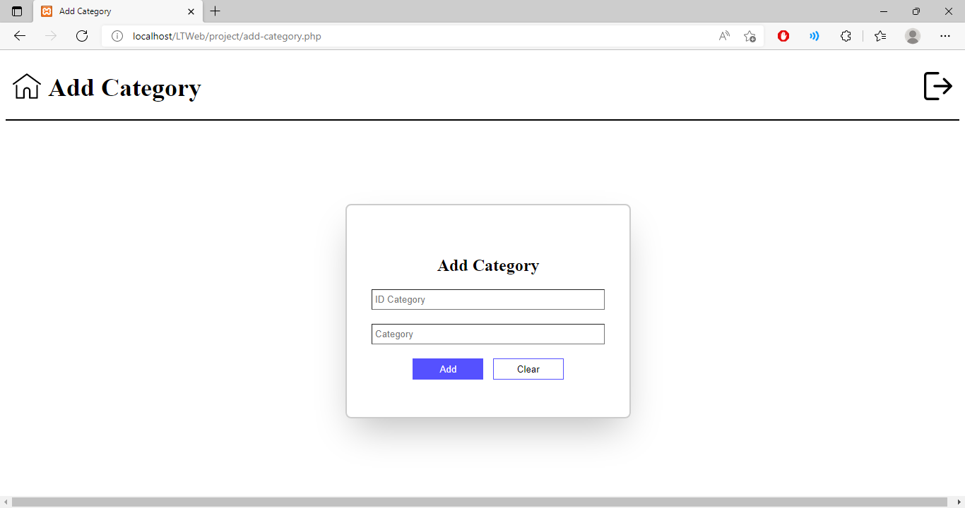

Slide 12
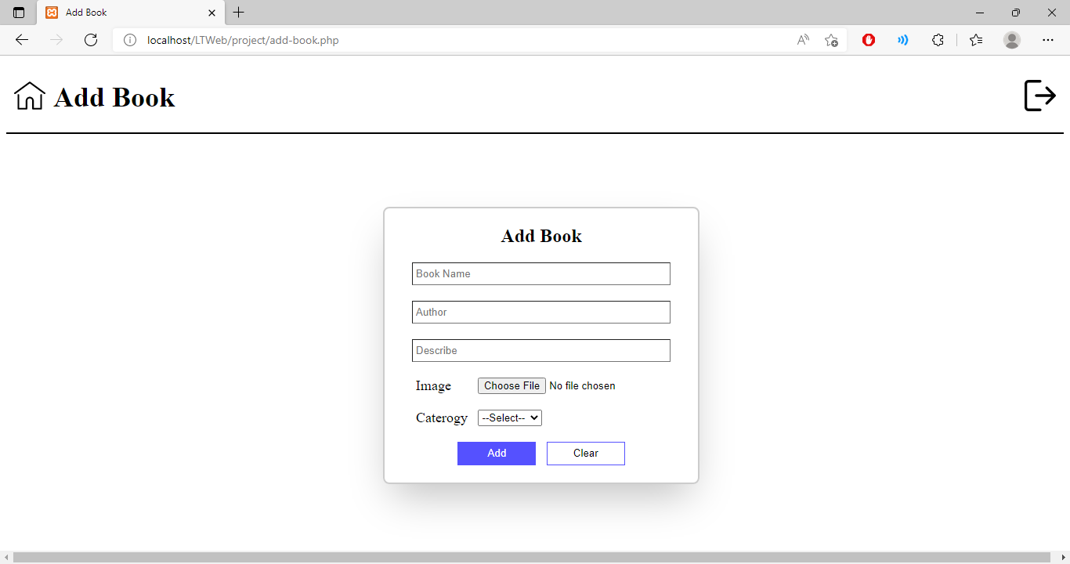

Slide 13
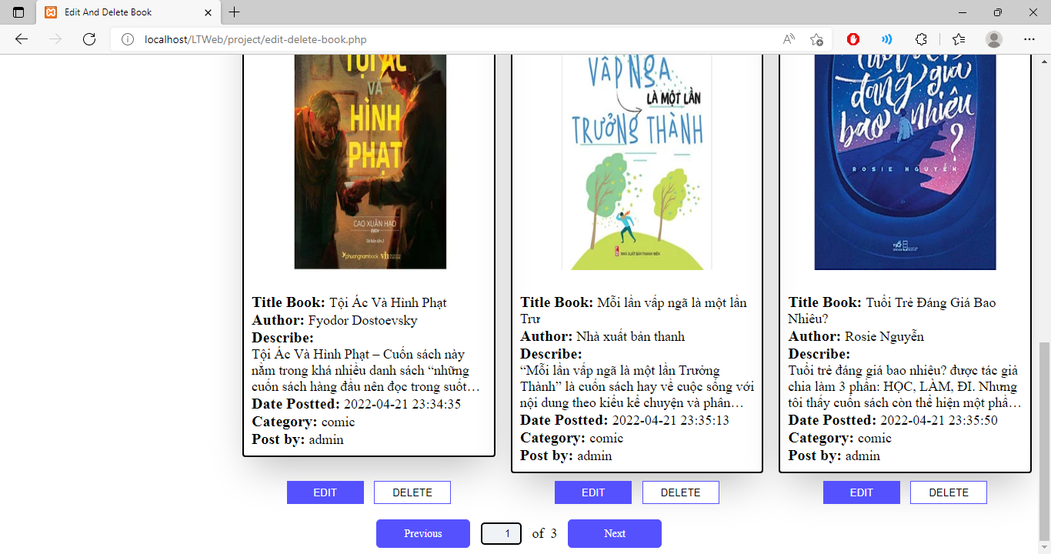

Slide 14
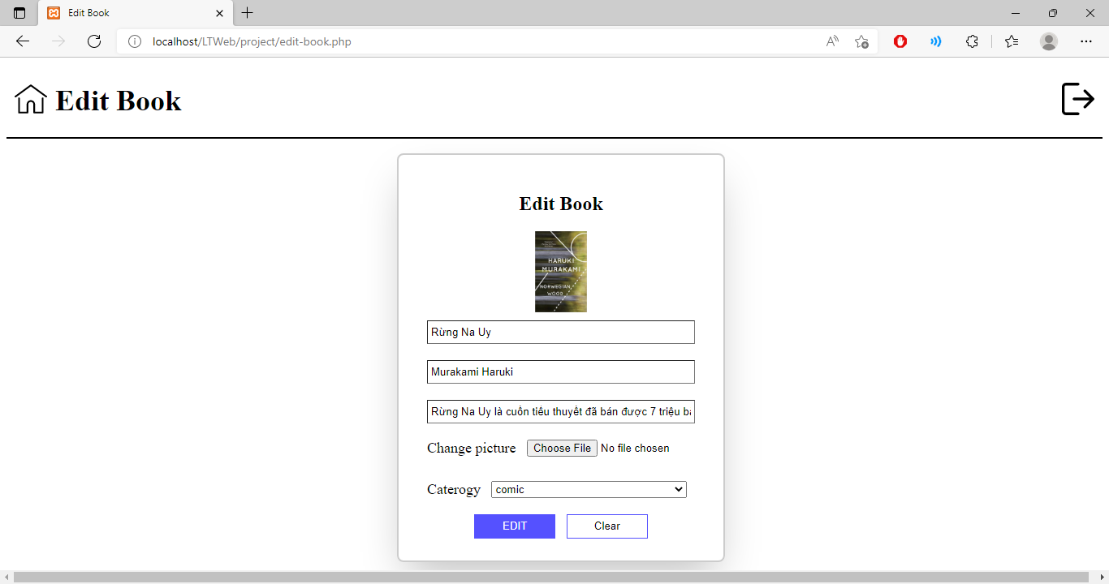

Slide 15
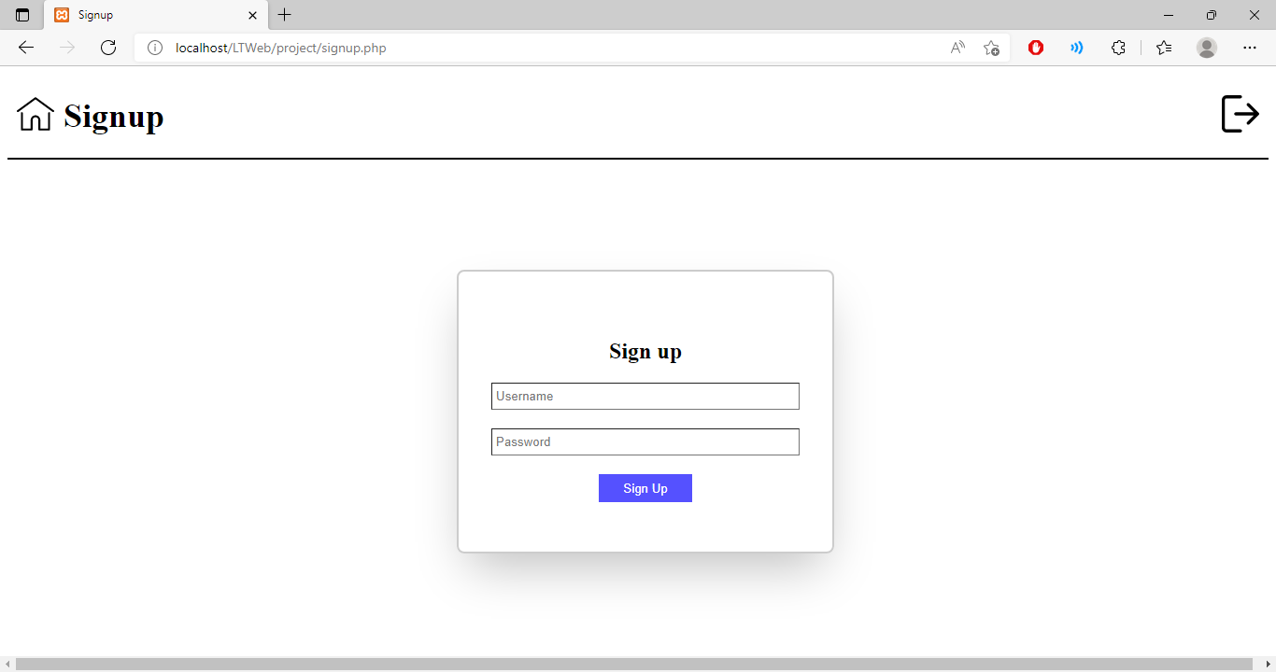

Slide 16
Thanks

